Slide 1
PERSONAL EXPENSE TRACKER SYSTEM
BY:ARUL DEEPIKA.A
AIDS-A

Slide 2
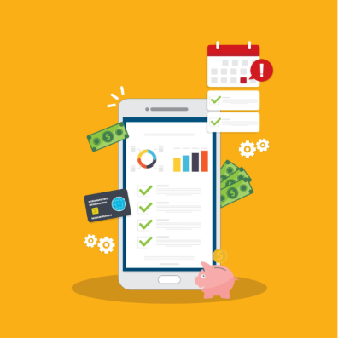
Introduction
Personal Expense Tracker is used to manage daily expenses.
It helps users record and monitor spending.
Makes financial planning easier.

Slide 3
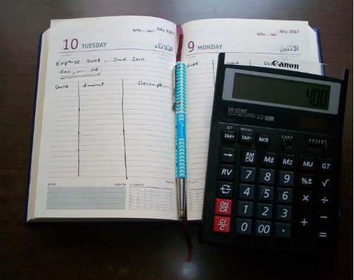

Problem Statement
Difficult to track daily expenses manually.
People may overspend without knowing.
Need a simple digital solution.

Slide 4
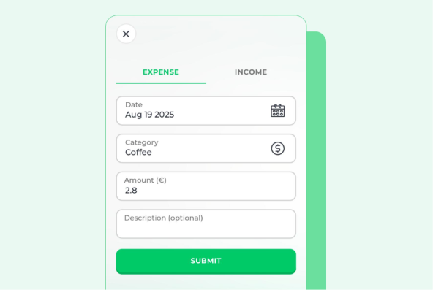
Objective
Track daily expenses.
Categorize spending.
Improve money management.
Generate expense summaries.
Frontend: HTML,CSS,Javascript
Backend:Java
Database:MySQL

Slide 5
Modules
Add Expense
View Expense
Edit Expense
Delete Expense
Monthly Summary
Advantages
Easy expense tracking
Better financial planning
Time saving
Organized records

Slide 6
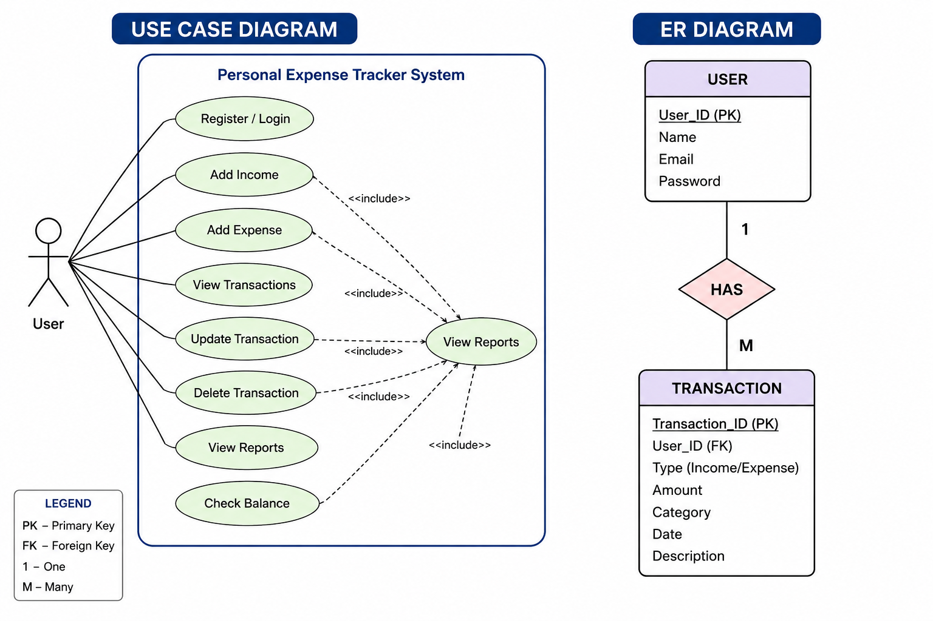
USE CASE DIAGRAM &ER DIAGRAM

